Slide 1
The Proxy Design Pattern
By Rees Byars

Slide 2
What is a Proxy?
An entity that acts on behalf of another entity
Voting by Proxy
Debit Cards

Slide 3
Proxy Pattern Basics
Proxy class controls access to Target class
AKA Surrogate
Proxy and target have same interfaces
Proxy holds reference to target

Slide 4
Benefits of Proxies
Reduce expense of excessively cloning a large object
Allow concurrent access to object
Provide client with illusion of mutual exclusion

Slide 5
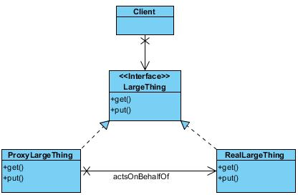
Basic Proxy Pattern Structure

Slide 6
Simple Implementation
interface LargeThing {
public void displayLargeThing();
}

Slide 7
Simple Implementation
class RealLargeThing implements LargeThing {
private String filename;
public RealLargeThing(String filename) {
this.filename = filename;
loadLargeThing();
}
private void loadLargeThing() {
//Loading code
}
public void displayLargeThing() {
//Display code
}
}

Slide 8
Simple Implementation
class ProxyLargeThing implements LargeThing {
private String filename;
private LargeThing largething;
public ProxyLargeThing(String filename) { this.filename = filename;
}
public void displayLargeThing() {
largething = new RealLargeThing(filename); largething.displayLargeThing();
}
}

Slide 9
JDK Proxy
java.lang.reflect.Proxy
java.lang.reflect.InvocationHandler
java.lang.reflect.Method

Slide 10
JDK Proxy Basics
SomeInterface proxy = (SomeInterface) Proxy.newProxyInstance( realThing.getClass().getClassLoader(), realThing.getClass().getInterfaces(), new MyInvocationHandler(realThing));
MyInvocationHandler implements handler, where you can define invoke method.

